Slide 1
COLLEGE AND STUDENT MANAGEMENT SYSTEM
Mentor –:
DR. AMRITA CHATURVEDI
By :
Dhruv Gupta 19074005
Megha Agarwal
19075045

Slide 2

OUTLINE
Objective
MOTIVATION
TECHNOLOGY
FUNCTIONS AND FEATURES
CONCLUSION

Slide 3
OBJECTIVE
The objective of College and Student Management System is to allow the administrator the ability to edit and find out the personal details of a student and professors and allows them to keep up to date their profile.
It facilitates keeping all the information of students such as their id, name, e-mail, date of birth, mark-sheet, subjects, attendance etc.
It also keeps the record of professors such as their name, id, e-mail, subjects, attendance sheet etc.
This integrated information management system connects daily operations in the college environment ranging from Attendance management to communicational means among students and teachers.

Slide 4
MOTIVATION
As we know that, a college consists of different departments, such as course departments, fees management, library, event management etc. Nowadays applications and uses of information technologies is increased as compared to before, each of these individual departments has its own computer system to do their own functionalities.
Supervising and maintaining the whole database of a school or college can be time-consuming and challenging especially if done on a regular basis.
By having one main system they can interact with each other from their respected system by having valid user id and password. So, we need to handle and manage everything smartly.
To solve this problem CSMS is used.
CSMS software makes it easy to track the record of every department of college and automate different functions. With CSMS everything can be seen on a single dashboard. The administrator can manage the college from anywhere.

Slide 5

TECHNOLOGY
This web application works on Django-python framework with the use of languages such as HTML, CSS, JavaScript for front end.
It uses MySQL as the relational database management system.
It uses the various inbuilt modules and functions provided by the Django framework and some of the custom modifications of them.

Slide 6
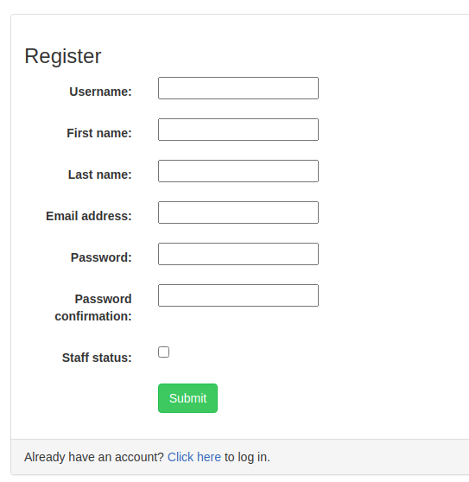
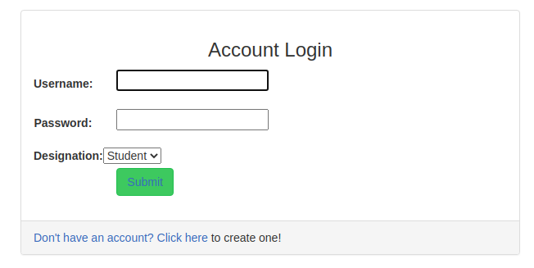
Functions And Features
REGISTERATION and LOGIN PAGE
It has all the authorization and validation of registration and login both as a student and a professor.

Slide 7

Functions And Features
This web application has three viewpoints:
FACULTY
• Each professor will be able to enter attendance for their respective students and download their attendance record in pdf format or any other extension that they have.
• Access to the information of all students that attend their courses.

Slide 8
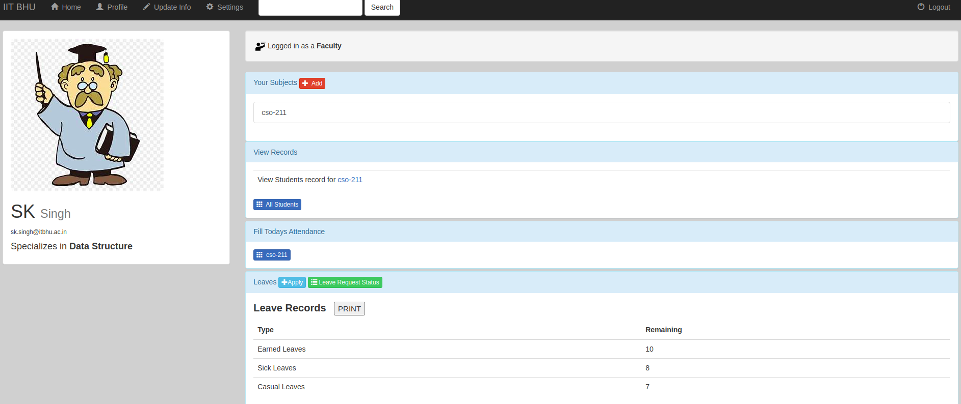

Slide 9
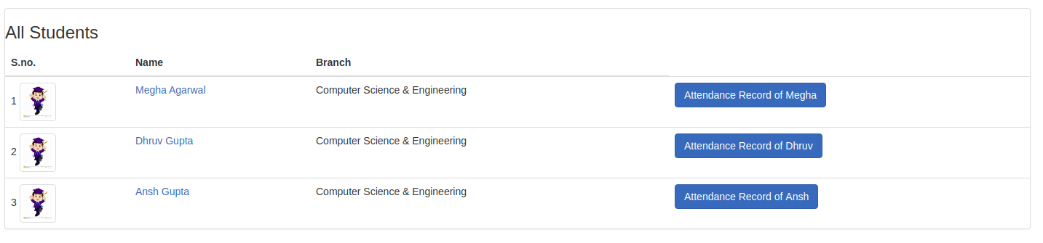
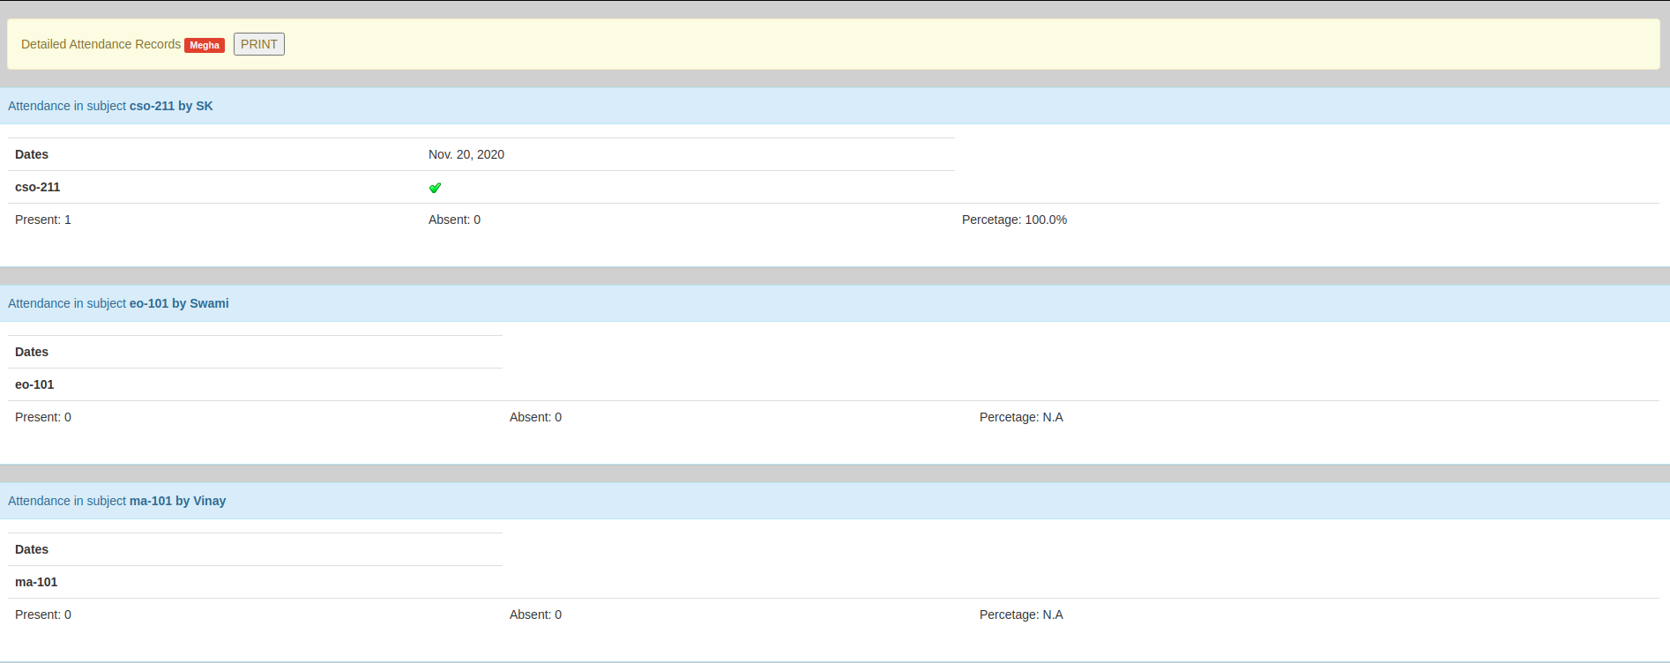

Slide 10

Functions And Features
STUDENT
• View the Attendance status of the courses to which they are enrolled.
• They can download their attendance record in pdf format or any other extension that they have.
• List of Courses in which they are enrolled.
• 10th, 12th and current CPI can be updated.
• They can update their profile information.

Slide 11
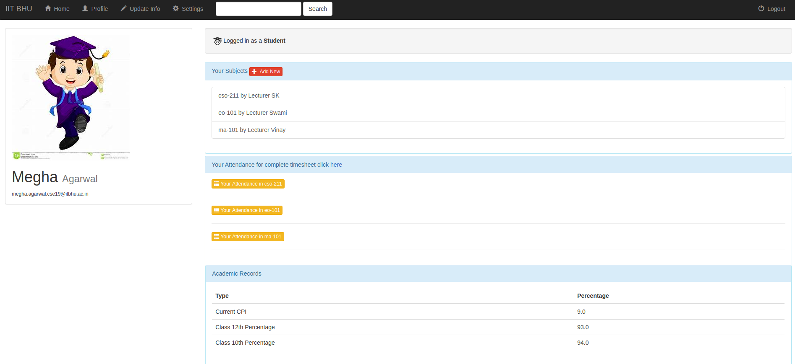

Slide 12
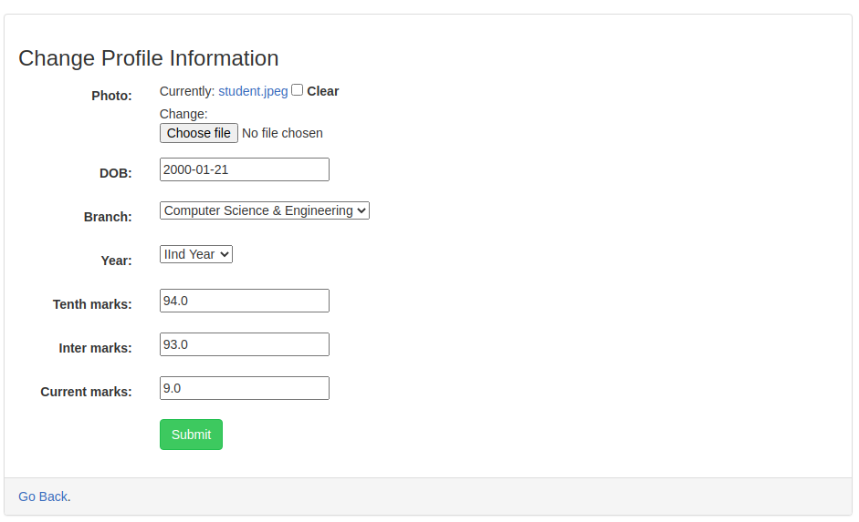

Slide 13
Functions And Features
ADMIN
• It has the access to the list of all the users
whether it be a professor or a student.
• It has the log of all the recent actions done by any user.
• It can make changes such as:
> Add and update students, teachers and courses.
> Assign teachers and students to courses.
> Delete any users.

Slide 14
CONCLUSION
The title of the project as CSMS is the system that deals with the issues related to a particular institution. It is the very useful to the student as well as the faculties to easy access to finding the details. The CSMS provides appropriate information to users based on their profiles and role in the system. This project is designed keeping in view the day to day problems faced by a college system.
The fundamental problem in maintaining and managing the work by the administrator is hence overcome. But by developing this web-based application, the amount of time consumption is reduced and also the manual calculations are omitted, the reports can be obtained regularly and also whenever on demand by the user. Thus the system developed will be helpful to the administrator by easing his/her task.
All years together gathered information can be saved and can be accessed at any time. The data which is stored in the repository helps in taking intelligent decisions by the management providing the accurate results.
This project is successfully implemented with all the features and modules of the college management system as per requirements.

